Slide 1



Movie Recommendation
System
Spendylove Apaloo

Slide 2

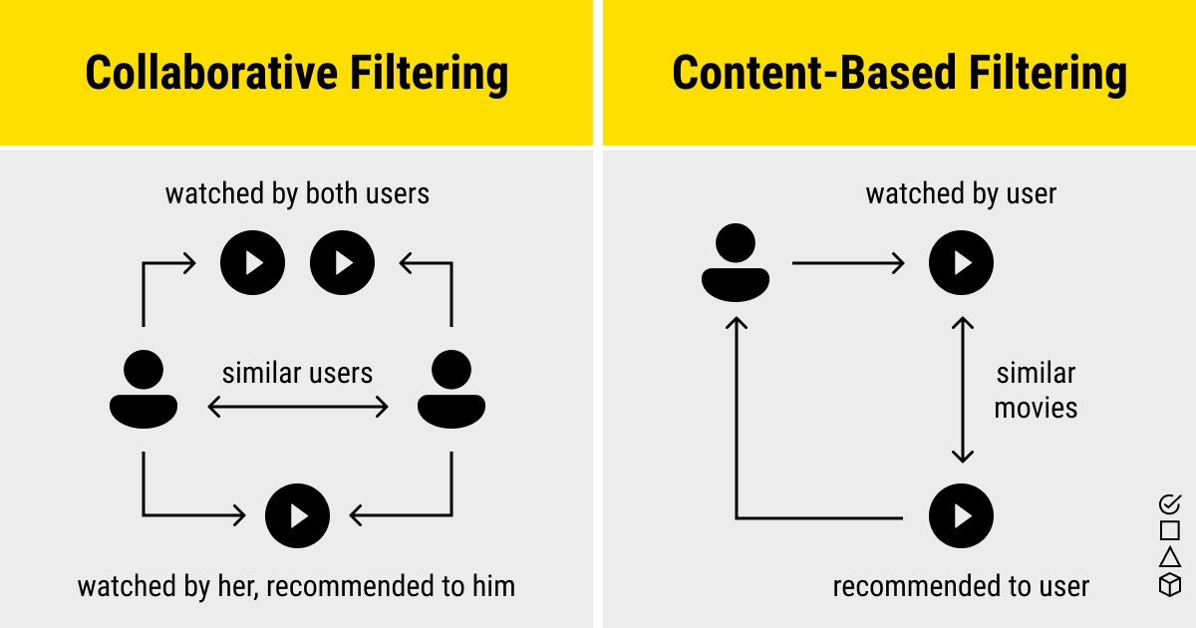

Types of Recommendation Systems

Slide 3

MovieLense Dataset
Preloaded in R in recommenderLab package
RealRatings Matrix using Movie and User data
99,392 movies rated
3 variables :
User- user ID.
Item – movie title.
Rating – User ratings (1-5)

Slide 4
Summary of Dataset
Total number of users: 943
Total number of movies: 1664
Maximum number of movie rated: 735 ~ 44% of the movies have been rated
Minimum number movies rated: 19
Avg number of movies rated : 105.4
50% of user have rated at most 64 movies

Slide 5
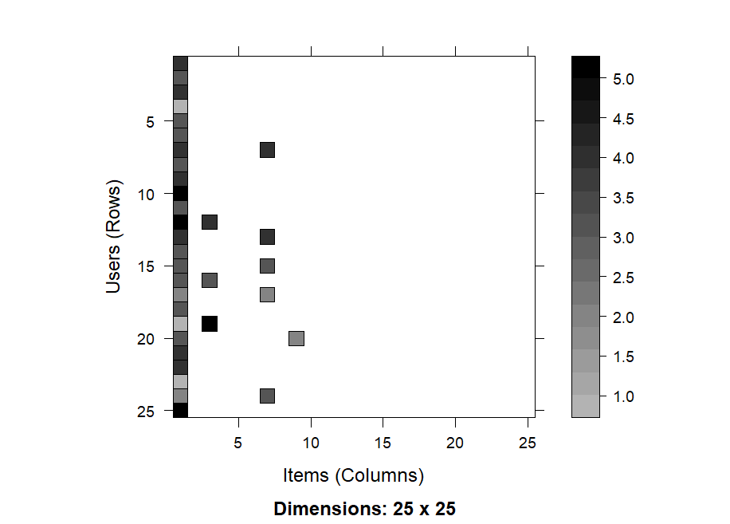
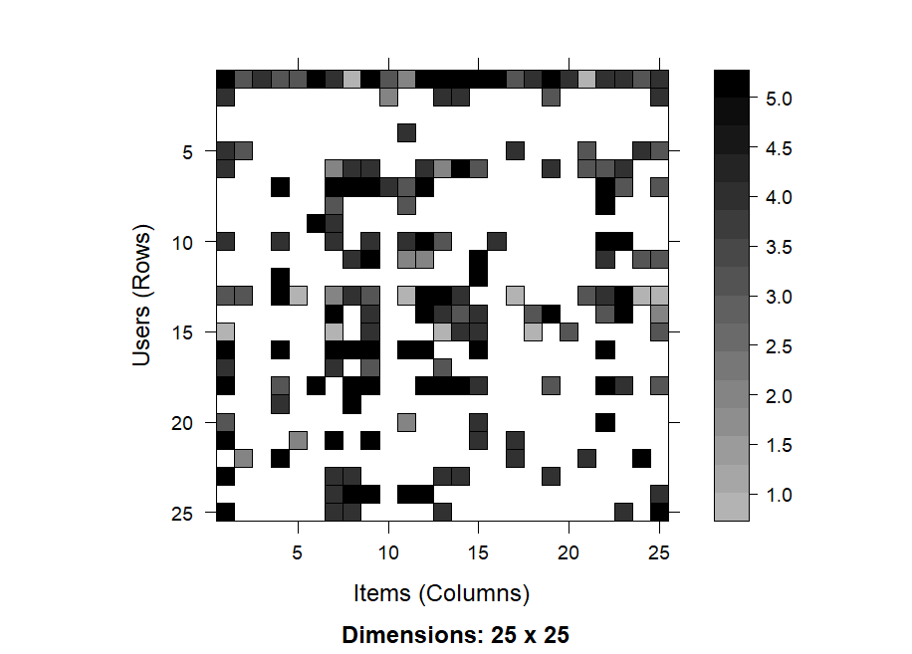
Why MovieLense?

Slide 6

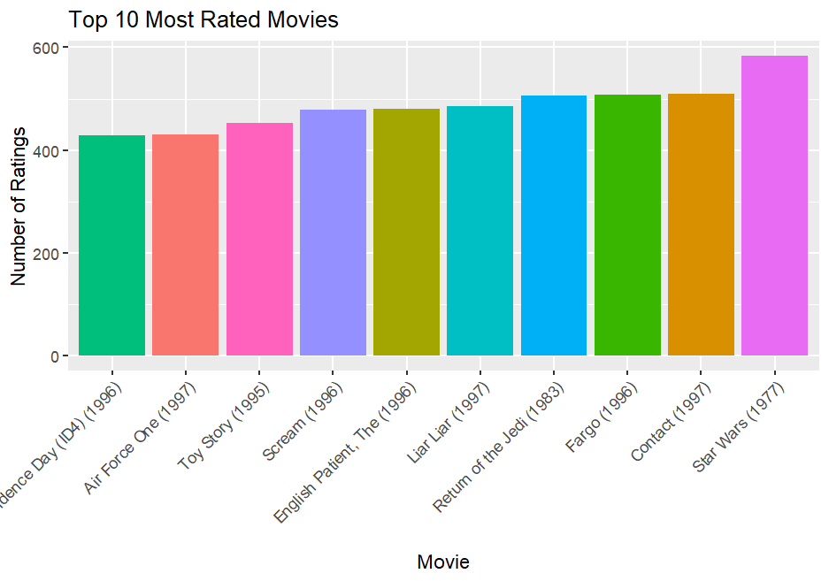

Slide 7
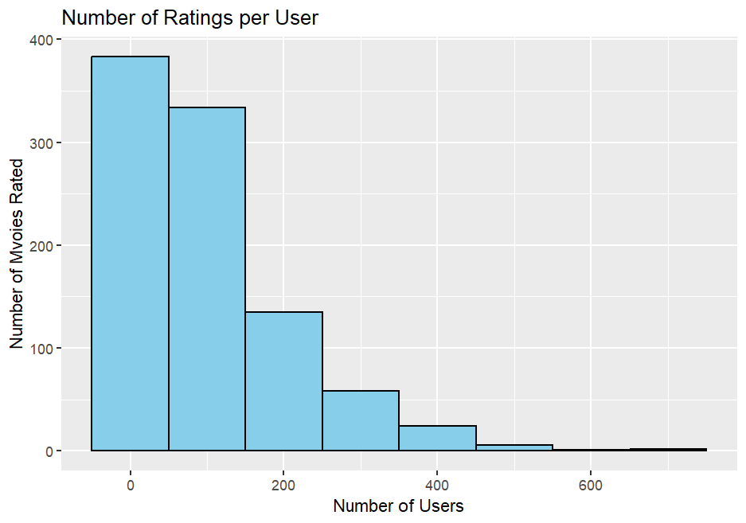
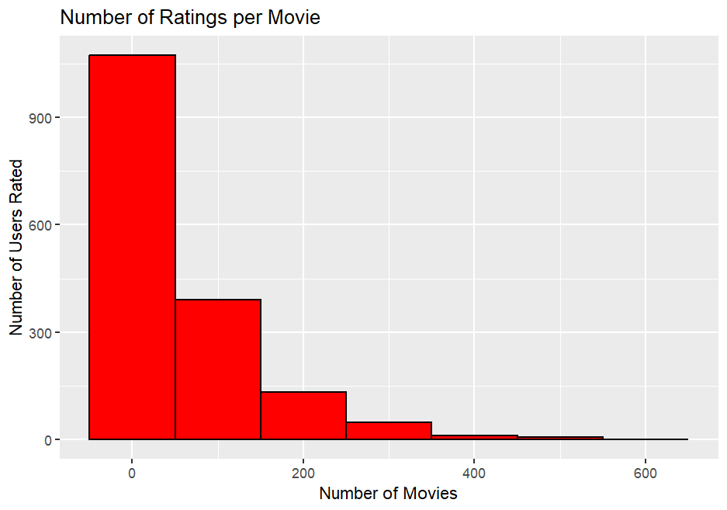

Slide 8
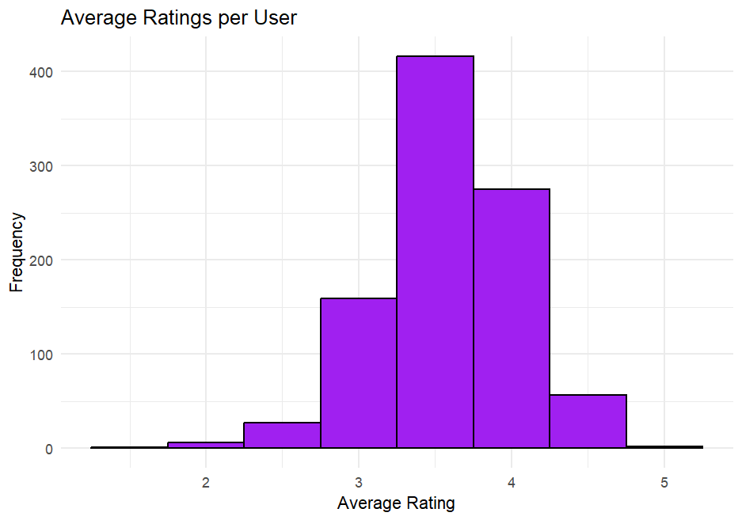

Slide 9


Common Issues
Longtail
Cold Start Problem
Sparsity
the issue of recommending items that don't have many interactions, like ratings
when a system can't make recommendations for a new user or item without any information about them. .
when there isn't enough data to identify similar users or items.

Slide 10

DEALING WITH SPARSITY AND
LONG TAIL

Slide 11
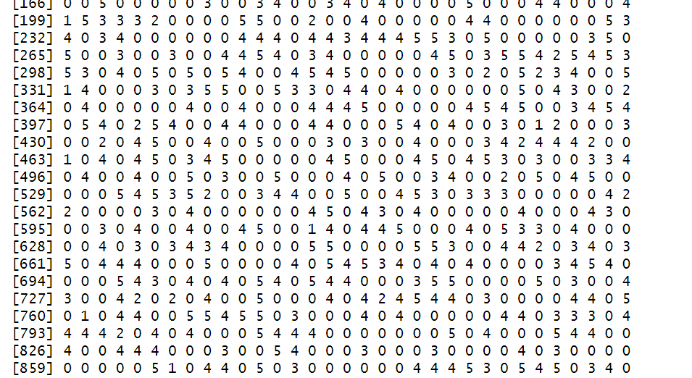

Slide 12
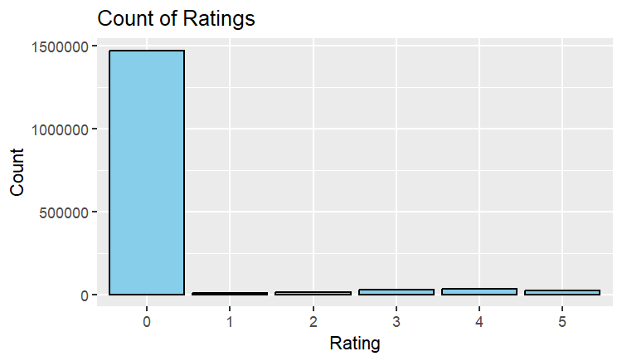
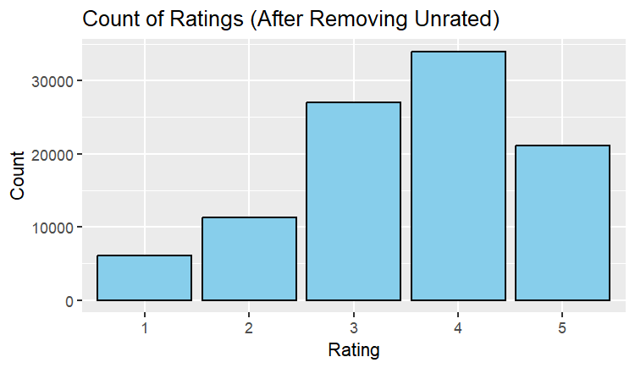
93% of cells are blank
7% of data is available
99,392 – user movie rating combo
Notes:
0 1 2 3 4 5
1469760 6059 11307 27002 33947 21077

Slide 13
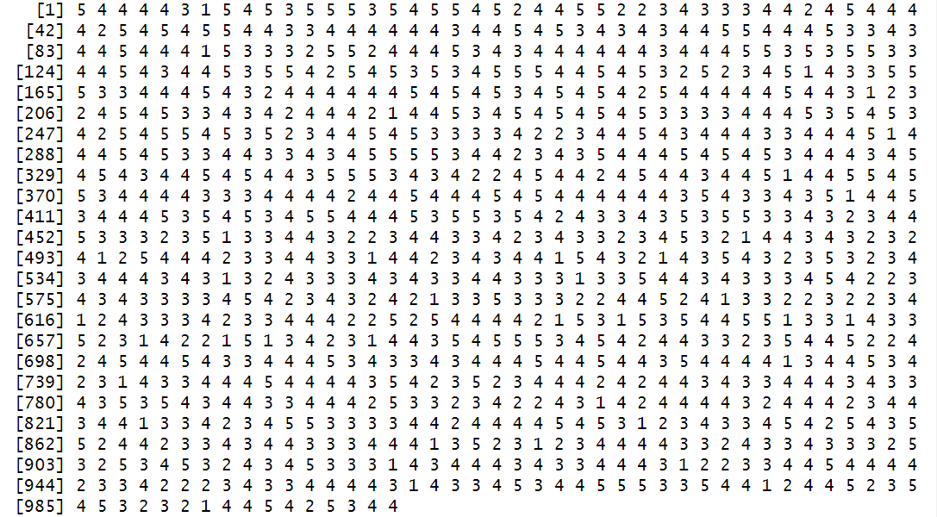

Slide 14

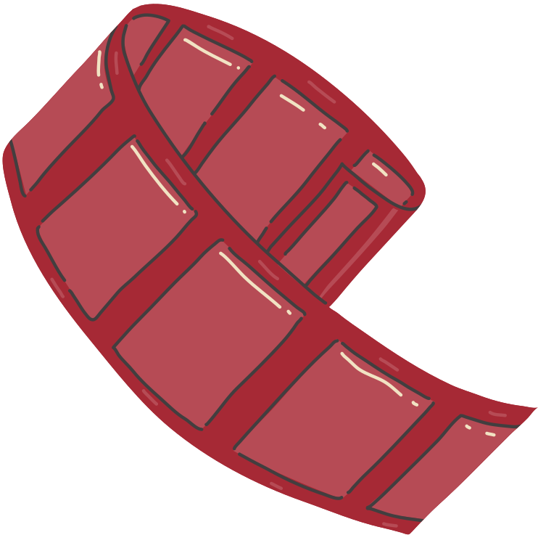
Recommendation System Using
User and Item Based Collaborative Filtering

Slide 15
USER BASED
ITEM BASED
[1] "Hoop Dreams (1994)"
"Bridges of Madison County, The (1995)"
[3] "Harold and Maude (1971)"
"Down by Law (1986)"
[5] "Shine (1996)"
"My Own Private Idaho (1991)"
[7] "Thin Blue Line, The (1988)"
"Paris, Texas (1984)"
[9] "Night on Earth (1991)"
"Dead Man (1995)"
[1] "Marlene Dietrich: Shadow and Light (1996) "
"Visitors, The (Visiteurs, Les) (1993)"
[3] "Gate of Heavenly Peace, The (1995)"
"Mamma Roma (1962)"
[5] "Jupiter's Wife (1994)"
"Wings of Courage (1995)"
[7] "Daniel Defoe's Robinson Crusoe (1996)"
"Very Natural Thing, A (1974)"
[9] "Walk in the Sun, A (1945)"
"Anna (1996)"
Notes:
item-based collaborative filtering outperforms user-based collaborative filtering in terms of prediction accuracy.

Slide 16



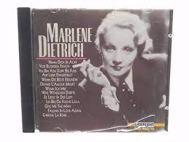

Slide 17

Model Accuracy
RMSE MSE MAE
USERBASED 1.157548 1.339916 0.9119129
ITEMBASED 1.072751 1.150794 0.8190476
Notes:
Lower values - item-based collaborative filtering outperforms user-based collaborative filtering in terms of prediction accuracy.

Slide 18


Thank you!
Elaborate on what you want to discuss.

Slide 19

Thank you!

